Slide 1
Hotel Booking Demand EDA
https://www.kaggle.com/datasets/jessemostipak/hotel-booking-demand
By Bei Chen and Yucen Xie

Slide 2
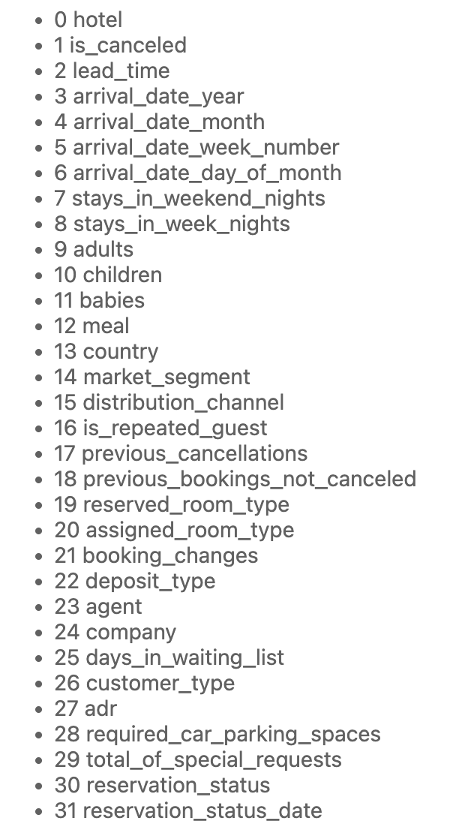
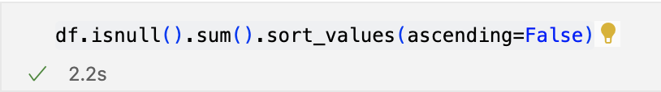
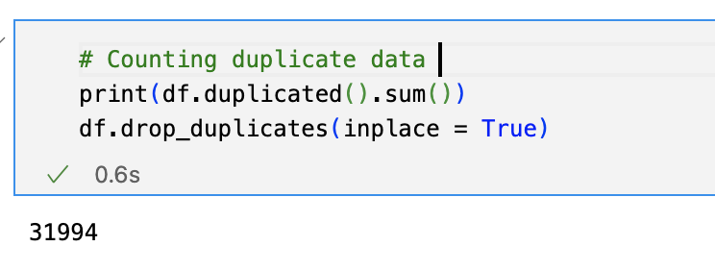
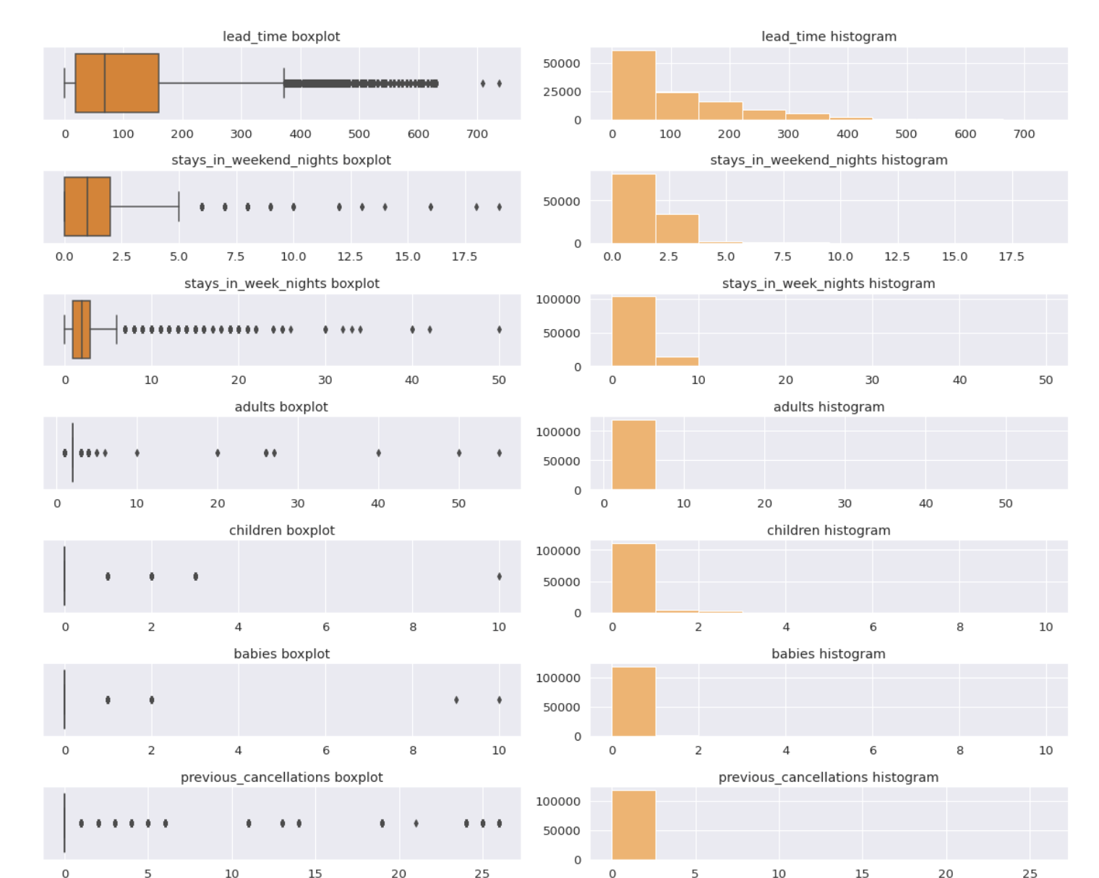
1.DataSet
2.Data processing
Step 1:
Lost data
Step 2:
Duplicate data
Step 3:
Outliers

Slide 3
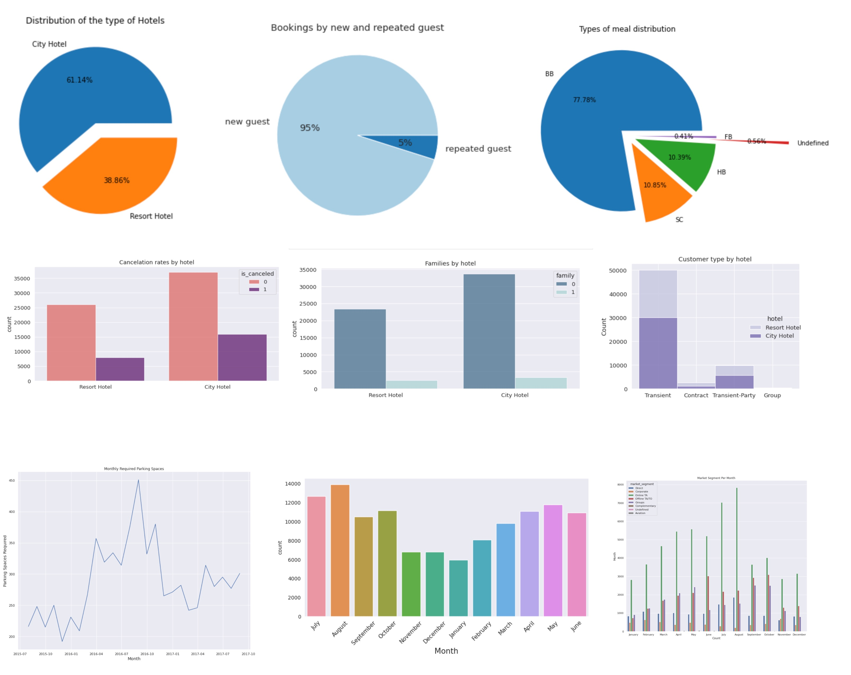
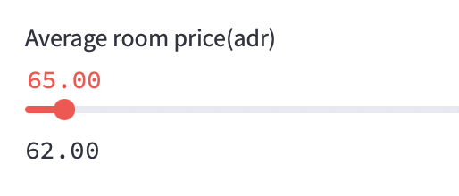
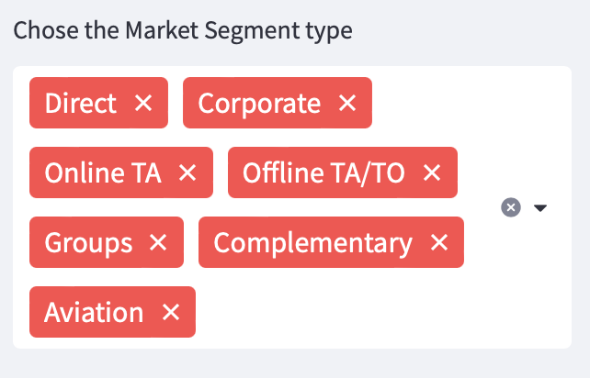
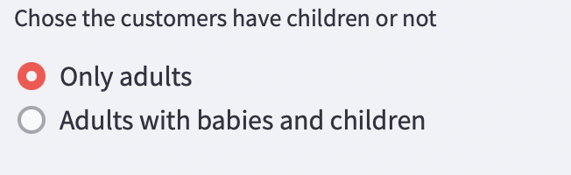
3.Basic information
4. Interactive variables
1.Average room price（adr）
2.Market Segment Type
3.Adults/Children/Baby

Slide 4
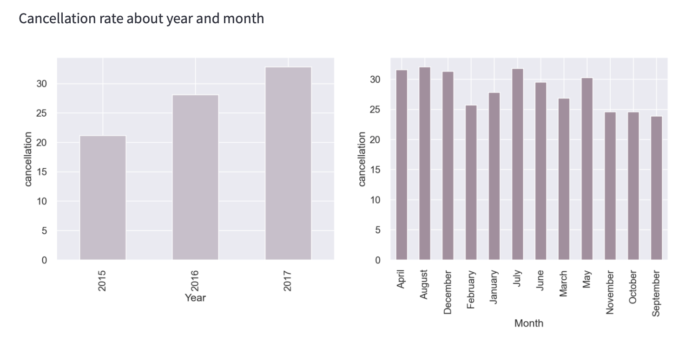
Q: What are the trends in cancellation rates?

Slide 5
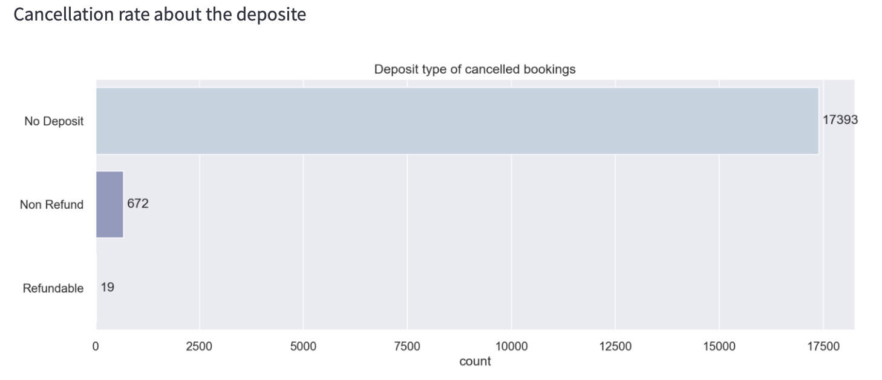
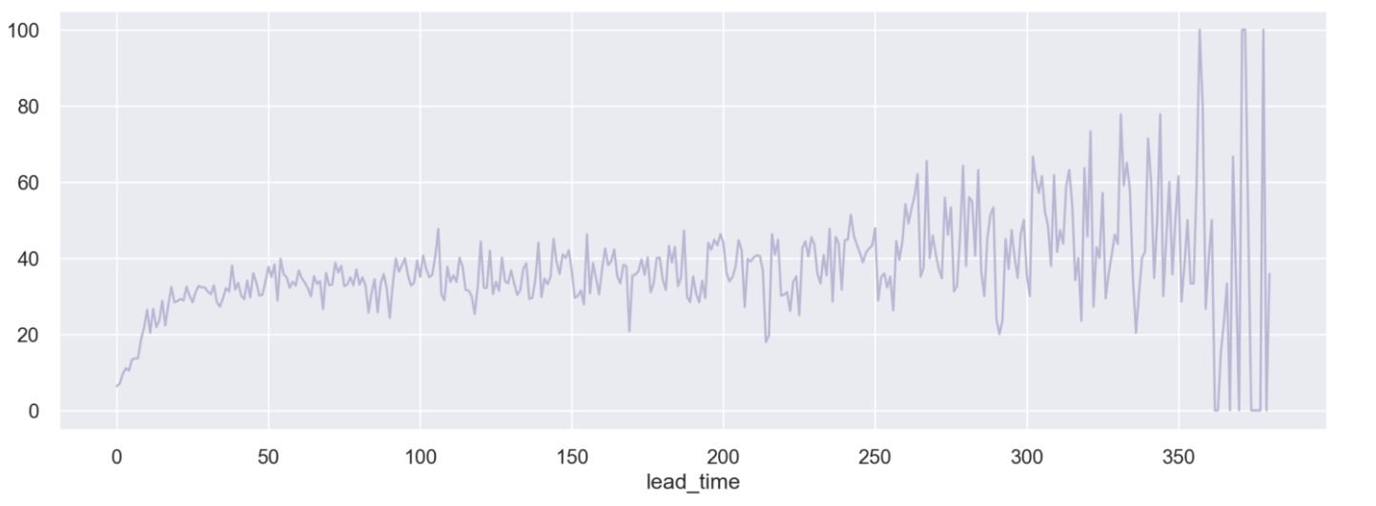
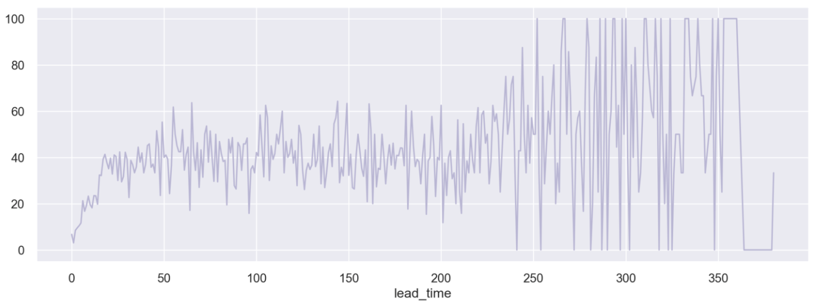
Factor 1:Deposit
Q : What factors
influence its
cancellation rate?
Factor 2:Lead time & children
Cancellation rate with children or not
Fluctuation Range
VS
Only adults
Adults with children

Slide 6
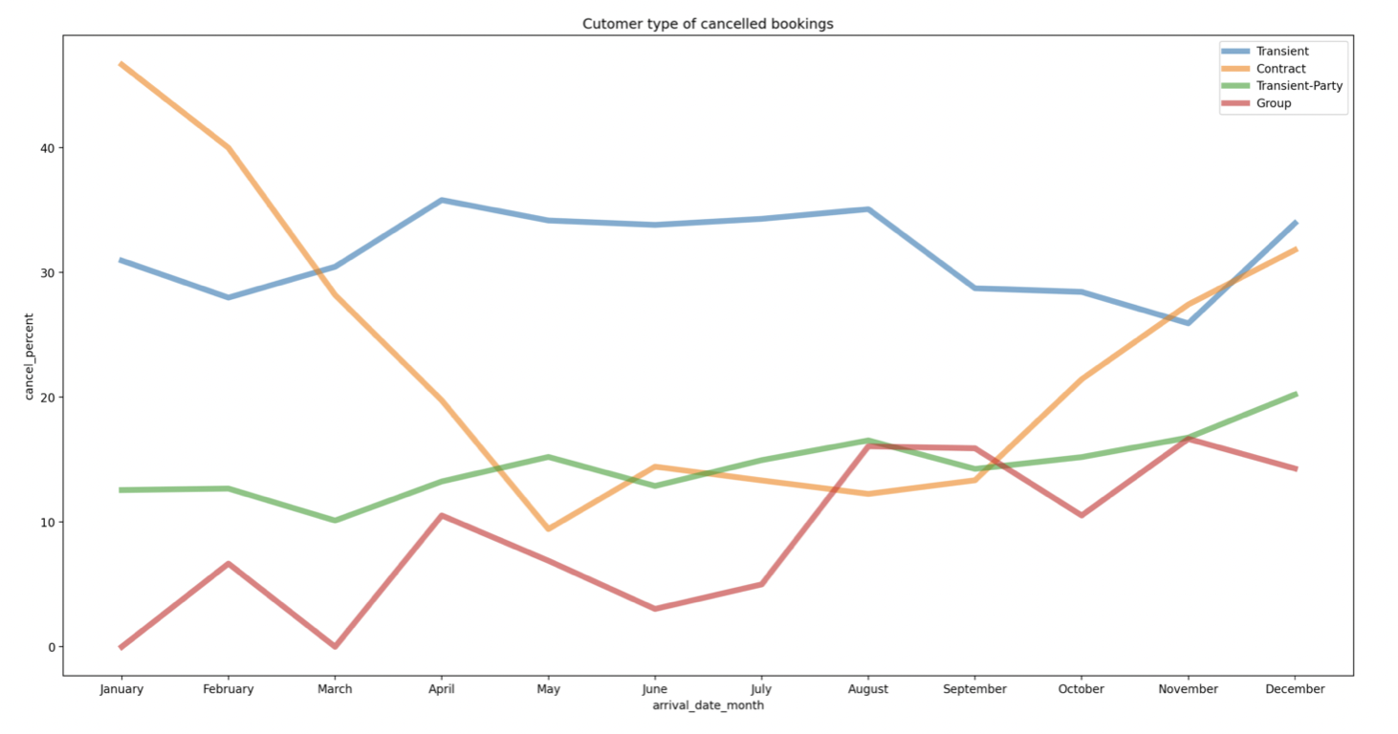
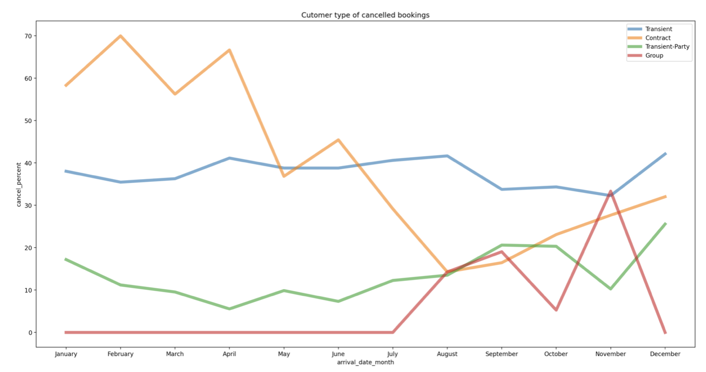
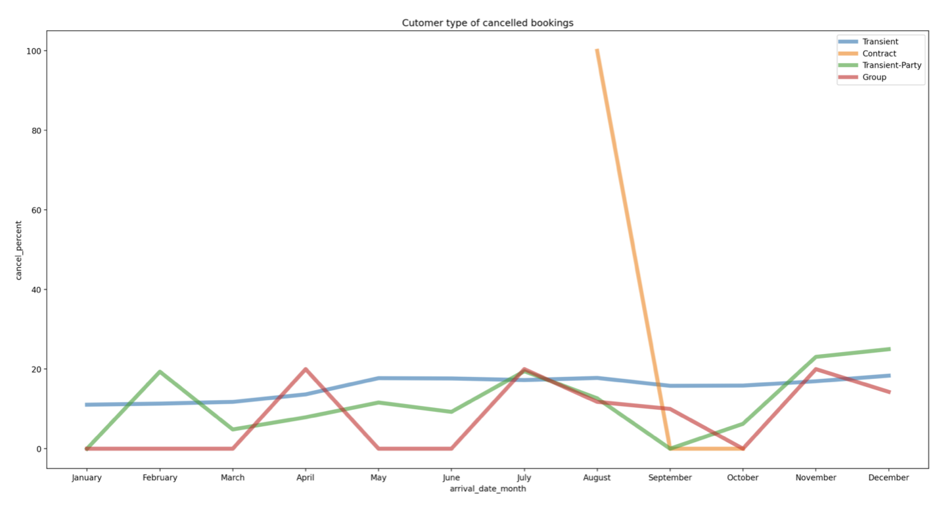
Factor 3:Lead time & children
Cancellation rate about customer type
When the way customers booking differently
Booking Online TA
The cancellation rate is low！
All the market segment
Booking directly

Slide 7
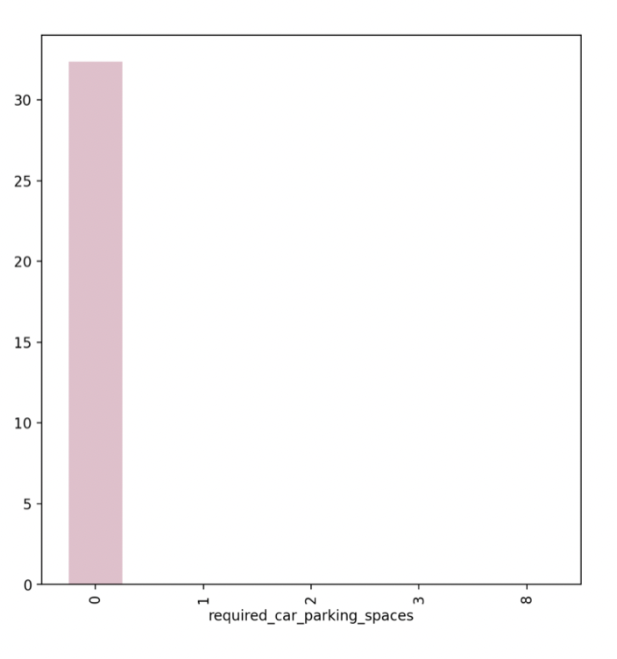
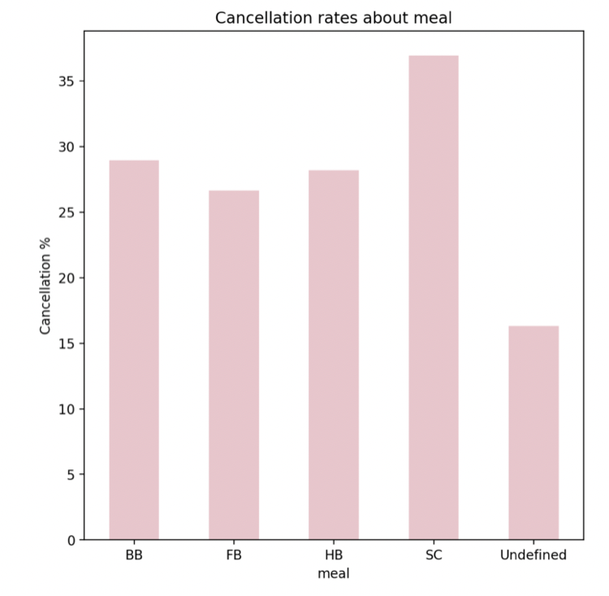
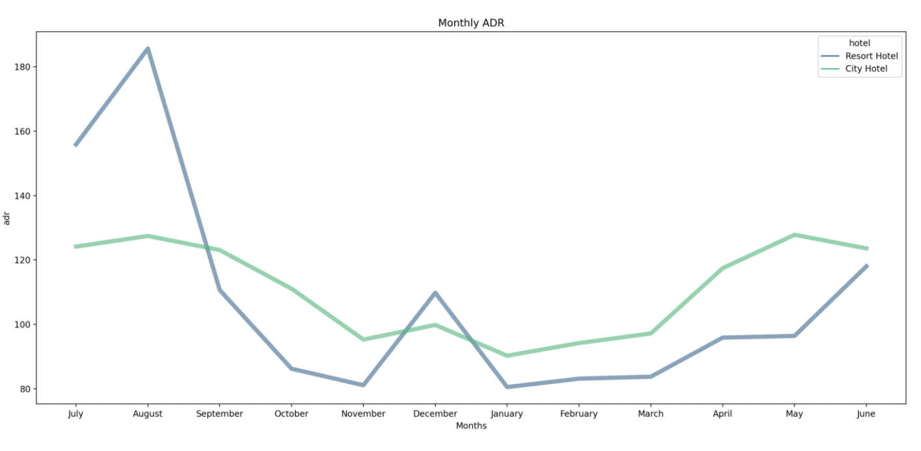
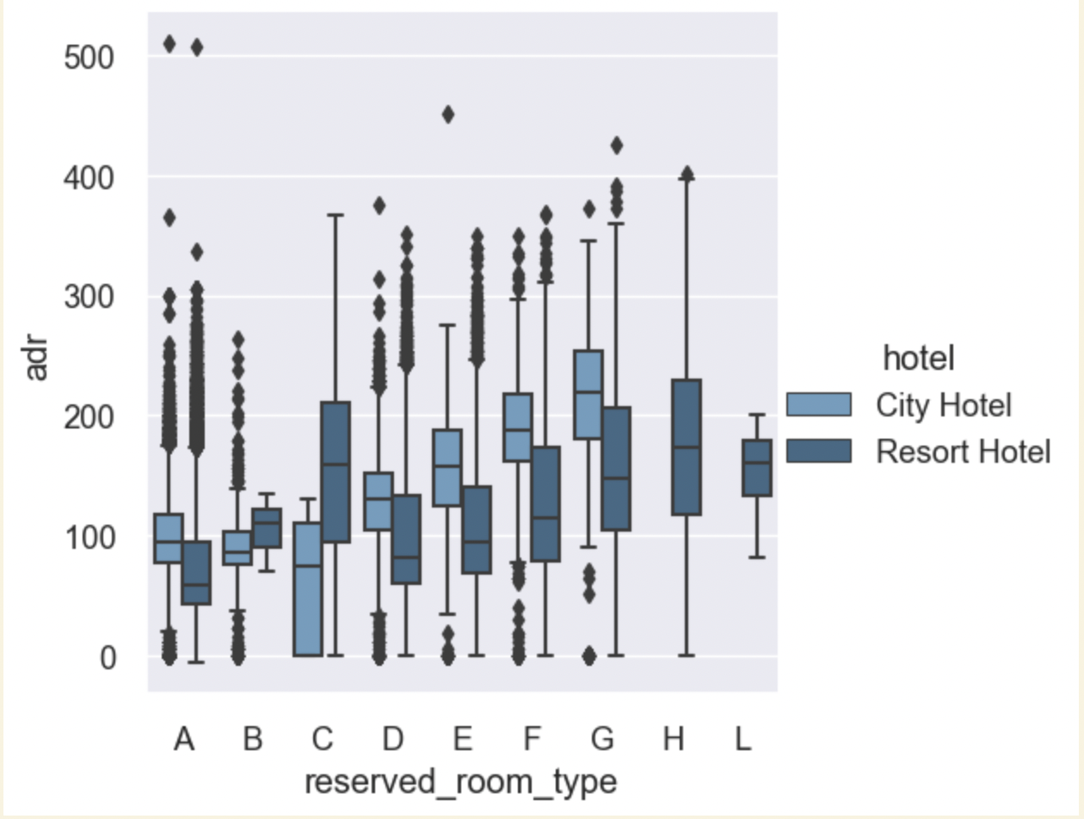
Book time in advance
With or without children
No deposit
Online segment
Offline segment
Meal
Carparking
Conclusion

